Slide 1

Face
Recognition Attendance System
for School Events
A Capstone Project presented to the
COLLEGE OF ENGINEERING
Jose Rizal Memorial State University
City of Dapitan in Partial Fulfillment of the Requirements
In
Software Design
Bachelor of Science in Computer Engineering II
2nd Semester S.Y. 2024-2025

Slide 2
FACE RECOGNITION ATTENDANCE SYSTEM
Team:
ALBAIRA, BORJA, CADALIN, CAMOC
JOSE RIZAL MEMORIAL STATE UNIVERSITY

Slide 3
INTRODUCTION
JJJOSE RIZAL MEMORIAL STATE UNIVERSITY

Slide 4
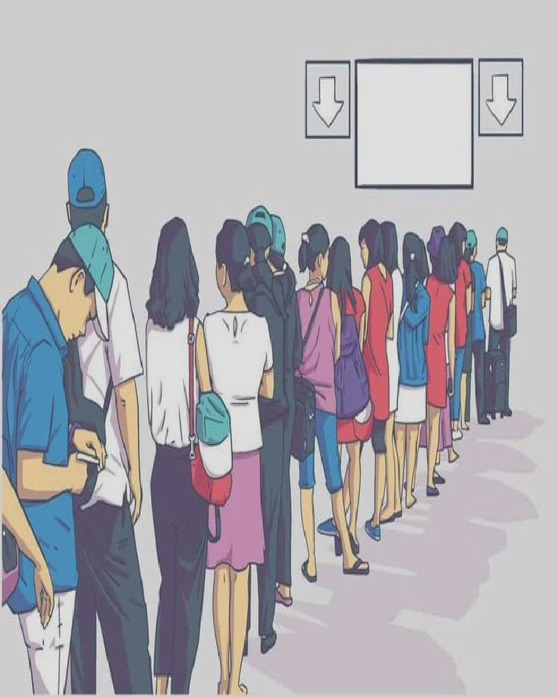
Problem
JOSE RIZAL MEMORIAL STATE UNIVERSITY

Slide 5
Scope
Web-based and AppSheet attendance tracking system for school events.
Integration with AWS Rekognition or OpenCV for face recognition. Database using PostgreSQL or MySQL for secure data storage. Hosted on AWS with backend powered by Java Spring Boot..
Attendance tracking for regular classes (this system is only for school events.
Integration with other school systems (unless specified later)..
Delimitation
Face recognition for secure and automatic attendance validation.
Biometric fingerprint or RFID-based tracking.

Slide 6
Functional Requirements
User Management: Admins can create, edit, and delete user accounts. Role-based access control for students, SSG officers, event organizers, and admins.
Event Management: Event organizers can create, edit, and delete events.
Attendance Tracking: SSG Officer verifies student attendance via Face recognition.
Attendance Reports: Admins can generate event attendance reports. Students can view their attendance history.
Security & Authentication: User login using credentials or Google/Facebook login. Secure API for communication between the website and backend.

Slide 7
Non-Functional Requirements
Performance: Must handle at least 200+ concurrent users without crashing. Attendance verification should take less than 5 seconds per student.
Usability: UI should be user-friendly for both students and SSG officers. Mobile-responsive design for better accessibility.
Security: Encrypted user data and secure authentication methods. Role-based access ensures only authorized users can perform specific actions.
Scalability: Backend should support future feature additions, like attendance analytics.
Reliability: The system should maintain 99% uptime during school events.

Slide 8
Entity Relationship Diagram
JOSE RIZAL MEMORIAL STATE UNIVERSITY

Slide 9
Wireframes
JOSE RIZAL MEMORIAL STATE UNIVERSITY

Slide 10
CURRENT PROGRESS
JJJOSE RIZAL MEMORIAL STATE UNIVERSITY

Slide 11
NEXT STEPS
JJJOSE RIZAL MEMORIAL STATE UNIVERSITY

Slide 12
END OF PRESENTATION
JOSE RIZAL MEMORIAL STATE UNIVERSITY

